Slide 1

KUMASI TECHNICAL UNIVERSITY (KsTU) LIBERAL STUDIES DEPARTMENT CRITICAL THINKING AND PROBLEM SOLVING BSC COMPUTER TECHNOLGY
DR. BENJAMIN ADJEI DANQUAH

Slide 2
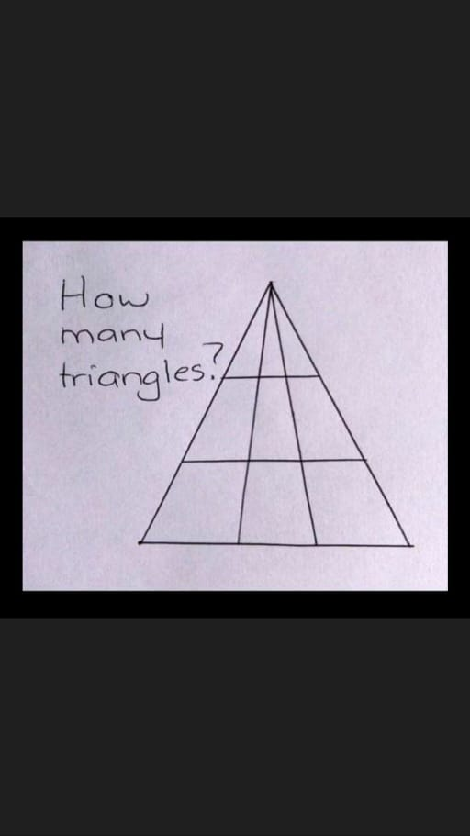

Slide 3
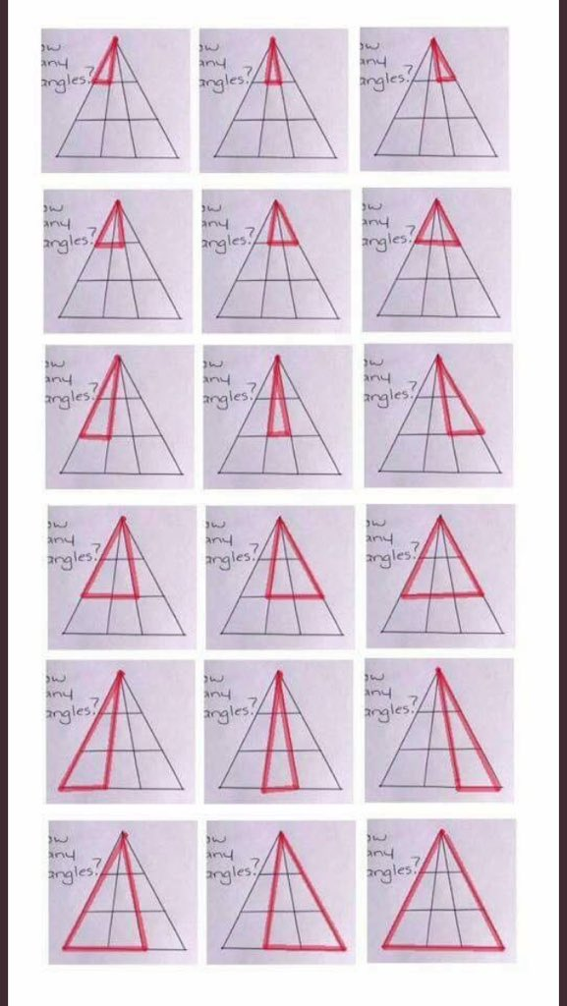

Slide 4
Objectives of the Lecture
Define Critical Thinking
Distinguish between Logic and Critical Thinking
Acquire Knowledge on abilities and Dispositions
Illustrate Claims, Truth, Value Judgment, Predictions and Probabilities.
Identify the importance of Logic and CT
Distinguish between factual and non-factual arguments
Examine various rhetoric ploys and their effects in speech and writing
Demonstrate how critical thinking helps us to develop excellent thinking and writing skills

Slide 5
According to Willingham, 2007 “Seeing both sides of an issue, being open to new evidence that disconfirms your ideas, reasoning dispassionately, demanding that claims be backed by evidence, deducing and inferring conclusions from available facts, solving problems, and so forth”
Some Definitions
A reflective and reasonable thinking that is focused on deciding what to believe or do” (Ennis, 1985)

Slide 6
A skillfull, responsible thinking that facilitates good judgment because, it relies upon critieria, is self-correcting and is sensitive to context. (Lipman, 1988, p.45)
Thinking that is goal-directed and purposive, aimed at forming a judgement, where the thinking itself meets standards of adequacy and accuracy (Bailin et. al 1999)
The practice of examining assumptions, discerning hidden values, evaluating evidence, and assessing conclusions (Myers 2003)

Slide 7
Relevance of Critical Thinking
Critical Thinking is important in our everyday activity
Critical thinking is relevant for self-examination
Critical Thinking Promotes Creativity
Science and governance require critical thinking
Critical thinking promotes racial, political and religious tolerance
Critical thinking improves language and presentational skills

Slide 8
Despite differences in definition, CT entails specific abilities:
Fair-mindedness
The propensity to seek reason
Inquisitiveness
The desire to be well-informed
Flexibility
Respect for, and willingness to entertain, others’ viewpoints
Skeptical
Independent

Slide 9
CRITICAL THINKING
Thinking that takes conscious effort.
We think without thinking
Core Critical Thinking Skills (Peter Facione, 2011)
Interpretation
Analysis
Inference
Evaluation
Explanation
Self-Regulation

Slide 10
Characteristics of Critical Thinkers
Observation
Curiosity
Objectivity
Introspection
Analytical thinking
Identifying biases
Determining relevance
Inference
Compassion and empathy
Humility
Willing to challenge the status quo
Open-mindedness
Aware of common thinking errors
Creative thinking
Effective communicators

Slide 11
Challenging Conventional Thinking
Conventional thinking is something that we have all been trained to accept. It is the thinking that we learn from our parents, our teachers, and the world around us. It is a pattern of thinking that has been established over time and is now widely accepted. However, challenging conventional thinking is crucial for progress and growth.

Slide 12
Some ways to Challenge Conventional Thinking
Question Everything
Take Risks
Embrace Failure
Surround Yourself with Diverse Opinions
Think Creatively

Slide 13
Differentiating Opinions, Perception and Beliefs (1/2)
Opinions are simply our thoughts and feelings about a particular subject or matter. They are subjective and can vary from person to person. For example, some people may like a certain type of music, while others may not.
Perception is how we interpret and make sense of the information we receive through our senses. It is our understanding of reality. For instance, if we see a glass half-full, we perceive it as being half-full. If we see it as half-empty, we perceive it as half-empty.

Slide 14
Differentiating Opinions, Perception and Beliefs (2/2)
Opinion is what you think about something.
Perception is the way you look at something.
Inter-relation:
Opinion may be influenced by experience, knowledge, and perception.
Perception can influence opinions.
Sequence:
Opinion is based on the perception.
Perception is formed before the opinion.

Slide 15
The impact of engagement on diversity and inclusion
Engagement is not just about being happy at work; it's about being committed to the organization's objectives and goals. It's about the willingness to go above and beyond for the greater good.
Diversity and Inclusion is more of a mindset that fosters the understanding and valuing of differences and creating an inclusive environment.
Inclusion is about respect, trust, and dignity, and without it, diversity efforts will not be successful.
Engagement is the key driver of diversity and inclusion as it fosters a culture of belongingness.

Slide 16
Factors that Drive Engagement
Belonging – feeling like part of a team, group, or organization
Purpose – understanding why one’s work matters
Achievement – a sense of attainment and accomplishment in the work that is done
Happiness – the pleasant feeling associated with and arising from work
Vigor – the existence of energy, enthusiasm, and excitement at work

Slide 17
SOME DIVERSITY AND INCLUSION INITIATIVES AND PRACTICES THAT CAN DRIVE ENGAGEMENT
Employee Resource Groups
Flexibility
Mentoring and Training

Slide 18
What Is Problem-Solving?
The term 'problem-solving' refers to the mental process that people go through to discover, analyze, and solve problems.
The problem-solving process involves:
1. Discovery of the problem.
2. Deciding to tackle the issue.
3. Seeking to understand the problem more fully.
4. Researching available options or solutions.
5. Taking action to resolve the issue.

Slide 19
Problem-Solving Mental Processes
Several mental processes are at work during problem-solving. Among them are:
Perceptually recognizing the problem.
Representing the problem in memory.
Considering relevant information that applies to the problem.
Identifying different aspects of the problem.
Labeling and describing the problem.

Slide 20
How to Apply Problem-Solving Strategies in Real Life
1. Create a flow chart - take advantage of the algorithm approach to problem-solving by sitting down and making a flow chart of each potential solution, its consequences, and what happens next.
2. Recall your past experiences - Think back to when you faced a similar issue, then use your knowledge and experience to choose the best option possible.
3. Start trying potential solutions - If your options are limited, start trying them one by one to see which solution is best for achieving your desired goal.
4. Take some time alone - Since insight is often achieved when you're alone, carve out time to be by yourself for a while. The answer to your problem may come to you, seemingly out of the blue, if you spend some time away from others.

Slide 21
Obstacles to Problem-Solving
• Assumptions: When dealing with a problem, people can make assumptions about the constraints and obstacles that prevent certain solutions.
• Functional fixedness: The tendency to view problems only in their customary manner. It prevents people from fully seeing all of the different options that might be available to find a solution.
• Irrelevant or misleading information: When trying to solve a problem, it's important to distinguish between information that is relevant to the issue and irrelevant data that can lead to faulty solutions. The more complex the problem, the easier it is to focus on misleading or irrelevant information.
• Mental set: A mental set is a tendency to only use solutions that have worked in the past rather than looking for alternative ideas. A mental set can work as a heuristic, making it a useful problem-solving tool.

Slide 22
How to Improve Your Problem-Solving Skills
• Recognize that a problem exists.
• Decide to solve the problem.
• Seek to fully understand the issue
• Research potential options.
• Take action.
• Try another option, if needed.

Slide 23
Insight Approach
In some cases, the solution to a problem can appear as a sudden insight. You are facing an issue in a relationship or your career when, out of nowhere, the solution appears in your mind and you know exactly what to do.
Insight can occur when the problem in front of you is similar to an issue that you've dealt with in the past. Although, you may not recognize what is occurring since the underlying mental processes that lead to insight often happen outside of conscious awareness.
Research indicates that insight is most likely to occur during times when you are alone—such as when going on a walk by yourself, when you're in the shower, or when lying in bed after waking up.

Slide 24
Insightful Approach to Problem Solving
Insight enables individuals to view a problem from a fresh perspective, assisting them in devising innovative and unique solutions.
You need to identify the problem clearly.
Conduct thorough research to gain a deeper understanding of the problem.
Continuously analyze the situation from different perspectives to gain valuable insight.
Consider all the available options and create a prioritized action plan based on the insights that you have gained.
Insightful approach to problem-solving is what sets apart comprehensive problem solver from the plethora of problem solvers

Slide 25
Strategically Assembling and Assessing Solution
To create an effective solution, strategy plays a vital role. Strategically assembling and assessing the solution helps in developing a strategic plan of action that ensures the success of the project.
Here are some ways in which we can strategically assemble and assess the solution:
Define the Problem
Identify the Stakeholders
Assemble Ideas
Assess the Solutions
Develop a Strategic Plan
Implement the Solution

Slide 26
TREND ANALYSIS
Trend analysis is a technique used in technical analysis that attempts to predict future stock price movements based on recently observed trend data. Trend analysis uses historical data, such as price movements and trade volume, to forecast the long-term direction of market sentiment.
Key Takeaways
Trend analysis tries to predict a trend, such as a bull market run, and then ride that trend until data suggests a trend reversal, such as a bull-to-bear market.
Trend analysis is based on the idea that what has happened in the past gives traders an idea of what will happen in the future.
Trend analysis focuses on three typical time horizons: short-; intermediate-; and long-term.

Slide 27
How Do You Prepare a Trend Analysis?
Identify the security or market you want to analyze
Gather the data
Organize the data
Analyze the data
Interpret the results
Use the results to inform your trading decisions:

Slide 28
Types of Trends to Analyze
1. Upward trend: Also known as a bull market, is a sustained period of rising prices in a particular security or market. Upward trends are generally seen as a sign of economic strength and can be driven by factors such as strong demand, rising profits, and favorable economic conditions.
2. Downward trend: It is also known as a bear market, is a sustained period of falling prices in a particular security or market. That are generally seen as a sign of economic weakness and can be driven by factors such as weak demand, declining profits, and unfavorable economic conditions.
3. Sideways trend: It is also known as a rangebound market, is a period of relatively stable prices in a particular security or market. They can be characterized by a lack of clear direction, with prices fluctuating within a relatively narrow range

Slide 29
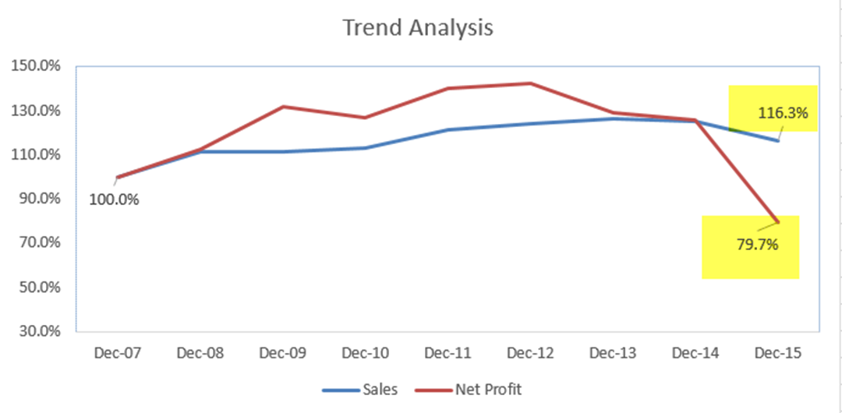

Slide 30
How Do You Prepare a Trend Analysis
1. Identify the security or market you want to analyze
2. Gather the data
3.Organize the data
4. Analyze the data
5. Interpret the results
6. Use the results to inform your trading decisions

Slide 31
Trend Analysis Pros and Cons
Pros
Can help identify opportunities for buying or selling securities.
Can identify potential risks or warning signs that a security or market may be headed for a downturn.
Provides insight into market psychology and momentum.
Cons
If markets are efficient, trend analysis is not as useful.
If the data is incomplete, inaccurate, or otherwise flawed, the analysis may also be misleading or inaccurate.
May not take into account changes in a company's management, changes in industry regulations, or other external factors that could affect the security's performance.
Different statistical measures can yield different results.

Slide 32
Data Visualization and Predictive Techniques
Data visualization and predictive techniques are crucial in today's data-oriented world. They allow us to turn vast amounts of information into clear and actionable insights.
Data visualization is the process of creating graphical representations of information. This process helps the presenter communicate data in a way that’s easy for the viewer to interpret and draw conclusions.
It involves transforming raw data into visual representations such as charts, graphs, and maps.
One of the key benefits of data visualization is that it enables us to quickly identify patterns and trends within the data. Each visualization has its strengths and weaknesses, so it is crucial to choose wisely

Slide 33
DATA VISUALIZATION TECHNIQUES
The type of data visualization technique you leverage will vary based on the type of data you’re working with.
Pie Chart, Bar Chart, Histogram, Gantt Chart, Heat Map, Box and Whisker Plot
Waterfall Chart, Area Chart, Scatter Plot, Pictogram Chart, Timeline
Highlight Table, Bullet Graph Choropleth Map, Word Cloud
Network Diagram, Correlation Matrices

Slide 34
Predictive Techniques
Predict future outcomes. They are widely used in various fields to forecast future outcomes or behaviors. These techniques use historical data to identify patterns and trends to :
Regression Analysis
Time Series Analysis
Artificial Neural Networks
Decision Trees
Random Forest

Slide 35
Market Predictive Techniques 1/2
Market predictive techniques are methods that use historical data to forecast future market movements. These techniques are widely used in the financial industry to make investment decisions.
There are several types of market predictive techniques, including:
Technical analysis is the study of past market data, primarily price and volume, to predict future market movements. This technique is based on the belief that market trends, patterns, and indicators can give signals about future price movements.

Slide 36
Market Predictive Techniques 2/2
Fundamental analysis, on the other hand, looks at the underlying factors that may influence the value of a market, such as economic data, company financials, and geopolitical events. This technique is based on the belief that these fundamental factors will eventually be reflected in the market price.
Quantitative analysis uses mathematical and statistical models to analyze market data. This technique is used to identify patterns and trends that may not be apparent through traditional technical or fundamental analysis.
Overall, market predictive techniques can be useful tools for investors. However, it is important to remember that they are not perfect and cannot always accurately predict market movements. It is crucial to use these techniques in conjunction with other factors, such as risk management and portfolio diversification, when making investment decisions.

Slide 37
Design thinking and creative problem solving
Design thinking is a process of problem-solving that puts the users or customers at the center of the solution. It involves empathy, ideation, prototyping, and testing. By following a design thinking approach, businesses can create innovative solutions that solve real-world problems.
Creative problem solving is a process that involves approaching problems in a creative and innovative way. It involves thinking outside the box and coming up with unconventional solutions. Creative problem solving is essential in today's rapidly changing business environment, where businesses need to adapt and innovate quickly.

Slide 38
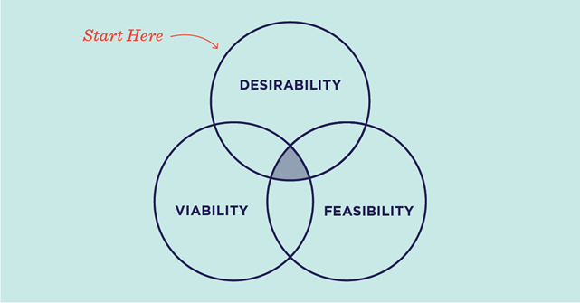
How Does Design Thinking Work
• Desirability: What makes sense to people and for people?
• Feasibility: What is technically possible within the foreseeable future
• Viability: What is likely to become part of a sustainable business model?

Slide 39
The design thinking framework includes the following steps:
Empathize: Understand the user's needs and pain points.
Define: Clearly define the problem that needs to be solved.
Ideate: Brainstorm potential solutions.
Prototype: Create a prototype of the solution.
Test: Test the prototype with users and gather feedback.
The creative problem solving framework includes the following steps:
Define the problem: Clearly define the problem that needs to be solved.
Generate ideas: Brainstorm potential solutions, no matter how unconventional they are.
Evaluate ideas: Evaluate the potential solutions based on feasibility, desirability, and viability. Implement the solution: Implement the best solution and monitor its effectiveness.

Slide 40
Ways to Get Started with Design Thinking
Gather Insights by Practicing Empathy, Observation, and Interviewing
Build Scrappy Prototypes to Learn About Unmet Needs
Gather Insights by Practicing Empathy, Observation, and Interviewing
. Turn Problems into Questions
Use Research to Understand the Past, Present, and Future

Slide 41
Creative problem-solving is traditionally based on the following key principles
Balance Divergent and Convergent Thinking
Reframe Problems as Questions
Defer Judgment of Ideas
Focus on "Yes, And" Instead of "No, But“

Slide 42
Creativity Techniques (1/2)
Brainstorming - It is a creative technique to generate new and imaginative ideas. This technique involves a group of people thinking of as many ideas as possible, with no criticism or evaluation.
Mind Mapping - It is a technique that creates a visual representation of ideas, information, and concepts. This method helps in organizing the information in a clear and concise manner.
SCAMPER - It is an acronym for Substitute, Combine, Adapt, Modify, Put to another use, Eliminate and Reverse. This technique helps generate new ideas by encouraging people to think creatively about existing products or services.
Random Word Technique - It involves taking a random word and using it as inspiration to generate new ideas. This method helps stimulate the mind and encourages thinking beyond the obvious.

Slide 43
Creativity Techniques (2/2)
Analogies – It involve comparing two dissimilar objects or concepts to generate new ideas. This technique helps in finding creative solutions to complex problems.
Mind Sweep – It technique involves writing down every idea, thought, or action that comes to mind. This technique helps to generate new ideas and identify potential solutions.
Storyboarding – It involves creating a visual sequence of events to generate new ideas. This technique is commonly used in the film industry but can be used in any context to generate creative solutions.

Slide 44
What is Innovation
Innovation is all about meeting the evolving needs and expectations of customers and bringing value to society, and the jobs to be done theory is a popular approach that can help achieve this goal. By identifying the specific jobs customers hire products or services for, businesses can develop more effective and customer-focused solutions.
According to the Organization for Economic Co-operation and Development (OECD) innovation is:
“The implementation of a new or significantly improved product (good or service) or process, a new marketing method or a new organizational method in business practices, workplace organization or external relations.”

Slide 45
The Fields of Innovation
Product Innovation
Technology Innovation
Business Model Innovation
Process Innovation
Marketing Innovation
Service Innovation
Organization Innovation

Slide 46
Types of Innovation (1/4)
Incremental Innovation: It usually results in the improvement of existing products, services, or processes. Incremental innovation increases value for customers and improves the efficiency of a company's operations.
Apple’s iPhone: Apple releases a new version of the iPhone nearly each year with small improvements to the camera, battery life, processing power, and other features.
Netflix’s personalized recommendations: Netflix continuously improves its recommendation algorithm to suggest better content for its users based on their viewing history.
Toyota’s hybrid cars: Toyota introduced its first hybrid car, the Prius, in 1997, and has since made incremental improvements to its hybrid technology to increase fuel efficiency and reduce emissions.

Slide 47
Types of Innovation (2/4)
2. Disruptive Innovation: Disruptive innovation changes the entire market and affects the way in which companies operate. Disruptive innovations create new markets or change the characteristics of existing markets by introducing new products, services, or processes.
Spotify: Spotify disrupted the music industry by offering a streaming service that allows users to listen to their favorite music on demand, without the need to purchase individual songs or albums.
Airbnb: Airbnb disrupted the hospitality industry by offering a platform for people to rent out their homes, apartments, and other properties as short-term rentals.
Square: Square disrupted the payment processing industry by offering a small card reader that allows merchants to accept credit card payments through their smartphones, without the need for traditional point-of-sale systems.

Slide 48
Types of Innovation (3/4)
3. Architectural Innovation: This innovation usually involves the reconfiguration of existing components and processes in a way that creates new capabilities. Architectural innovation recombines existing technologies in new ways to provide new value to customers.
Zara’s fast fashion supply chain: Zara’s fast fashion supply chain integrates design, production, and distribution processes to create a highly responsive and efficient supply chain that can quickly respond to changing fashion trends.
Toyota’s lean production system: Toyota’s lean production system is a highly efficient and flexible manufacturing system that focuses on reducing waste, improving quality, and increasing productivity.
GE’s Ecomagination: GE’s Ecomagination initiative focuses on developing sustainable products and solutions that reduce environmental impact. The initiative includes a range of technologies, such as wind turbines, smart grid systems, and energy-efficient lighting.

Slide 49
Types of Innovation (4/4)
4. Radical Innovation: Radical innovation involves the creation of entirely new products, services, or processes that do not exist in the market. It requires a high level of creativity and a significant investment in research and development.
Entirely new industries have grown because of these innovations:
development of the internet
the smartphone
electric vehicles
3D printing technology

Slide 50
Why an Innovation Strategy is Important
Companies that fail to innovate risk being left behind by competitors who are nimbler and more responsive to changing customer needs.
As a result of Innovation, a company can explore new markets, create new products or services, and develop new revenue streams.
Continuously improving products or services, and developing new solutions, allows a company to enhance customer satisfaction and loyalty.
By leveraging new technologies or developing more efficient ways of doing things, a company can reduce costs, improve productivity, and increase profitability.

Slide 51
How do you Encourage Innovation in your Business
Foster a Culture of Innovation
Provide resources and support
Reward and recognize Innovation
Encourage diversity and inclusion
Embrace emerging technologies
Encourage open communication
Set goals and metrics

Slide 52
Innovation Practices and Tools of Engagement
Innovation is not just about coming up with new ideas, but it's also about implementing them effectively. In today's fast-paced world, one needs to be creative, adaptable, and innovative to stay ahead of the competition.
“Innovation requires knowledge, ingenuity, and, above all else, focus.” – Peter Drucker

Slide 53
Innovation Practices
Embrace a Growth Mindset: A growth mindset allows you to see challenges as opportunities for growth and learning. It helps you stay open to new ideas and learn from your mistakes.
Foster a Culture of Innovation: Encourage your team members to share ideas, experiment, and take calculated risks. Celebrate small wins, and learn from failures.
Stay Customer-Focused: Your innovation efforts should be focused on solving your customers' problems. Listen to their feedback, and design solutions that meet their needs.
Use Design Thinking: Design thinking is a human-centered approach to problem-solving. It involves empathizing with your users, defining the problem, ideating solutions, prototyping, and testing.

Slide 54
Tools of Engagement
Social Media: Social media is a powerful tool for engaging with your customers and getting feedback on your ideas. Use social media platforms to share your ideas, gather feedback, and connect with your audience.
Crowdsourcing: Crowdsourcing involves tapping into the collective intelligence of a large group of people to generate ideas or solve problems. It can be done through online platforms or offline events.
Hackathons: A hackathon is a focused event where participants work in teams to solve a specific problem or create a new product or service. It's a great way to foster innovation and collaboration among your team members.
Innovation Labs: An innovation lab is a dedicated space where team members can experiment, learn, and collaborate on new ideas. Innovation labs can be physical spaces or virtual environments.

Slide 55
What is an Innovative Team
Innovative teams comprise individuals from different departments, divisions, and walks of life within a company. This conglomerate of different personalities and styles can help foster creativity because people are able to see things from different perspectives related to their history, values, and role within the company.
Diversity of ideas, backgrounds, careers, values, and more is critical when developing a team.
Most innovative teams will also appoint a team leader who is responsible for establishing processes, facilitating discussions, and collecting input. The team leader should be someone who inspires and is able to “bring the best out” of everyone involved in the process.

Slide 56
What skills do Innovation Teams Need
Creative and critical thinking: These skills may seem opposite, but they are both equally important to the innovation process. Creative thinking allows for the free flow of new ideas, whereas critical thinking allows teams to narrow in on ideas they think can work and should be investigated more.
Empathy: It is all about being able to connect and understand others. This trait is important because it can help teams better understand their end users and stakeholders and design with them in mind.
Curious mindset: Teams who are curious are invested in testing different solutions and pushing themselves to learn more.
Problem-solving and collaboration: Being able to identify and define challenges and works well with teammates, colleagues, and customers or users to co-create solutions.

Slide 57
Leading and Maintaining Innovation Teams (1/2)
Innovation teams need a leader who can inspire creativity and guide the team to successful outcomes. To lead and maintain an innovation team, you need to understand certain vital factors that impact the team's productivity and growth.
Firstly, the team's culture must be one of experimentation and risk-taking. Encouraging team members to think outside the box and come up with unique ideas can lead to exciting breakthroughs in the innovation process.
Secondly, effective communication is integral to the success of any innovation team. Keeping everyone on the same page is crucial in guiding the team towards the right direction. Encourage open communication throughout the team, promote dialogue and insights on a regular basis.

Slide 58
Leading and Maintaining Innovation Teams (2/2)
Thirdly, focus on team member’s motivation by providing challenging work. It'll keep the team invested in their work while maximizing productivity. Encourage ownership and responsibility, it will build a culture of accountability that drives the team to thrive.
Finally, it's essential to recognize that setbacks and failures are part of the innovation process. Leaders must encourage their teams to embrace failure as an opportunity to learn and grow through failure analysis. It's also important to create an environment of positive reinforcement that allows your team to feel and celebrate success along the way.

Slide 59
Introduction to Prototyping
Prototyping is an essential stage in the product development process that helps evaluate the functionality of a product before it is launched. Prototypes can be in form of a physical model created with different materials or a digital model that can be tested and refined.
There are two main types of prototyping:
Low-fidelity prototypes are quick and easy to create. They are used to evaluate the general idea and basic concepts of the product and can be created with inexpensive materials such as paper and cardboard.
High-fidelity prototypes, on the other hand, simulate the final product as closely as possible. They are used to evaluate the product's usability, functionality, and design.

Slide 60
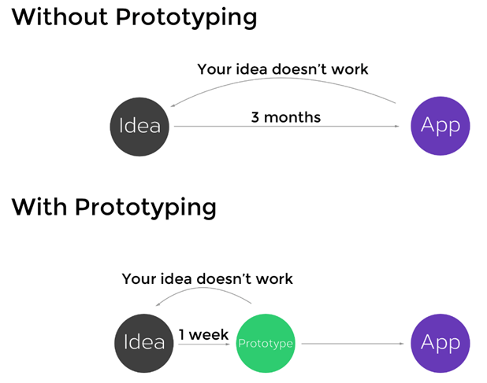

Slide 61
The Benefits of Prototyping
1. Prototyping helps to detect and fix early problems.
2. They can be built fast, and cheaply.
3. Prototyping enables the user to build, observe, and learn quickly.
4. Prototyping enhances collaboration within a team and enables everyone to visualise the same idea.
5. Prototypes allow feedback from users quickly.
6. Prototypes are able to be iterated easily.

Slide 62
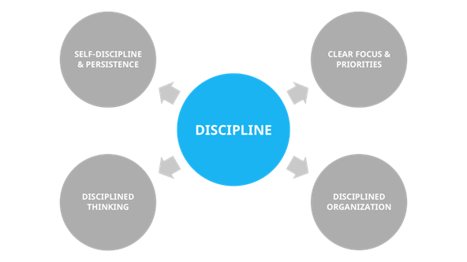
Maintaining a Disciplined Innovation Culture
Maintaining a disciplined innovation culture is a crucial factor for the growth and success of any organization.
It takes a consistent effort and commitment to create an environment that nurtures new ideas while also ensuring that these ideas are implemented in a disciplined manner.

Slide 63
Some Key Strategies for Maintaining a Disciplined Innovation Culture (1/2)
1. Clearly Define Your Innovation Goals: Start by defining clear innovation goals and objectives that align with your organization's overall strategic plan. This will help to ensure that your innovation efforts are focused and aligned with your core business goals.
2. Foster Communication and Collaboration: Encourage open communication and collaboration across departments and teams to create a culture of creativity and innovation. By breaking down silos and encouraging cross-functional teamwork, you can increase the likelihood of generating fresh ideas and perspectives.
3. Embrace Failure: Failure is an inevitable part of the innovation process. Embrace it and use it as a learning opportunity to refine your ideas and approaches. Encourage a culture of experimentation and acknowledge that some ideas will fail.

Slide 64
Some Key Strategies for Maintaining a Disciplined Innovation Culture (2/2)
4. Establish Clear Processes and Procedures: Clearly define the processes and procedures for evaluating, developing, and implementing new ideas. This will help to ensure that new innovations are thoroughly vetted and aligned with your organization's strategic goals.
5. Foster a Culture of Continuous Learning: Encourage ongoing learning and development to help your employees stay up-to-date with the latest trends and technologies. By investing in your employees' professional development, you can create a more dynamic and agile culture that's better equipped to innovate and adapt to changing market conditions.
Overall, maintaining a disciplined innovation culture requires a balance of creativity and structure. By embracing a disciplined approach to innovation, you can maximize your organization's potential for growth and success.

Slide 65
DISCUSSIONS AND QUESTIONS
THANK YOU

